Slide 1


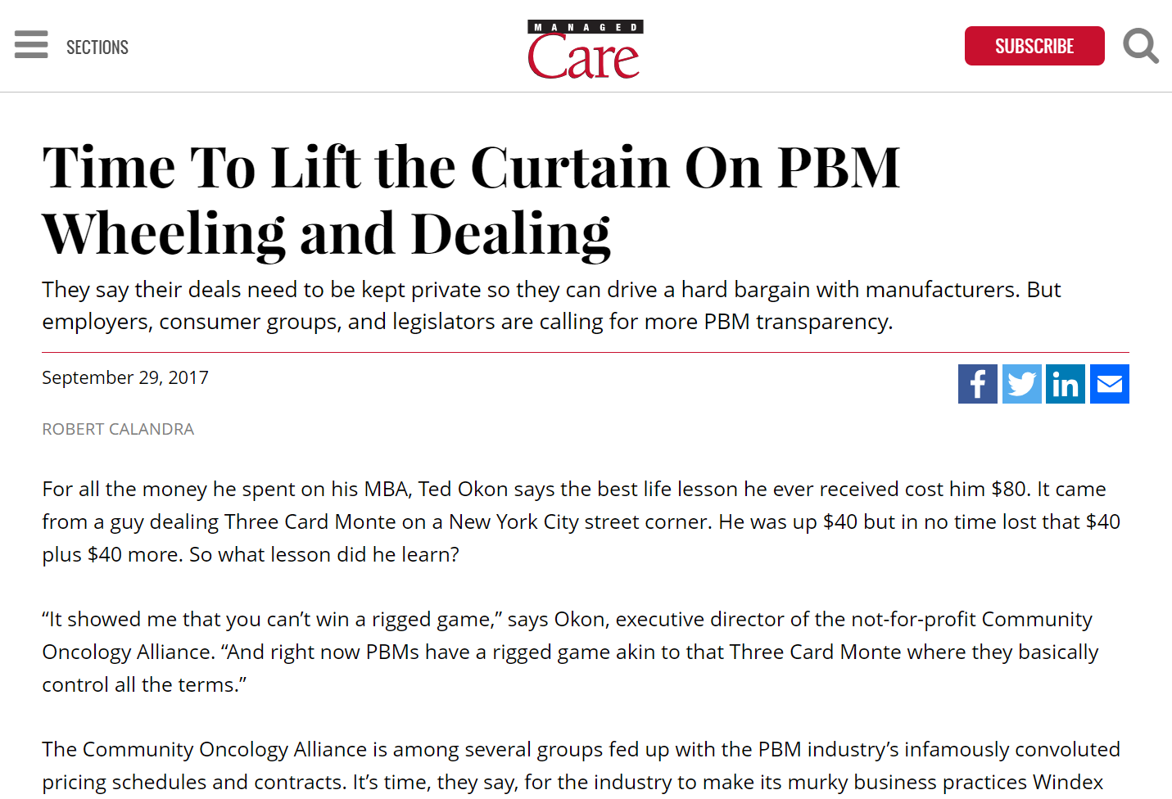
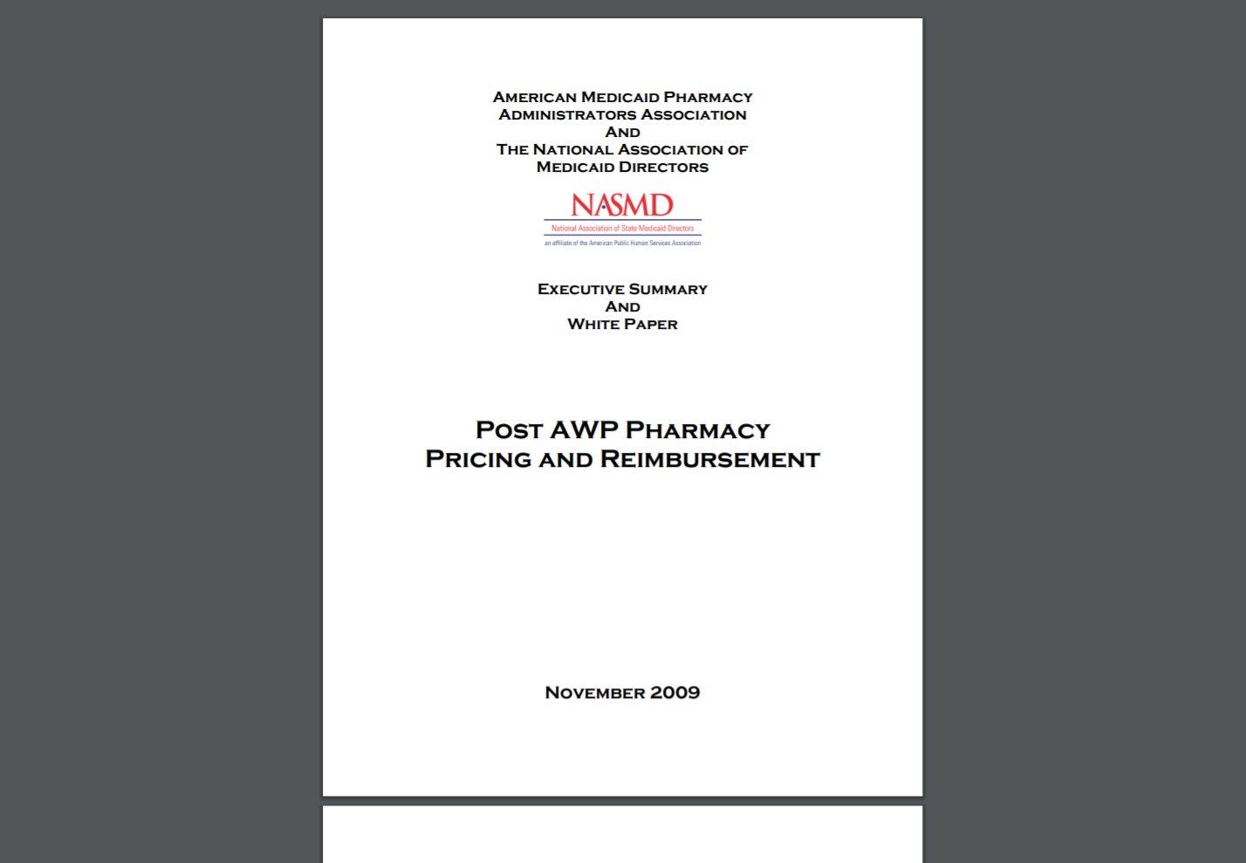
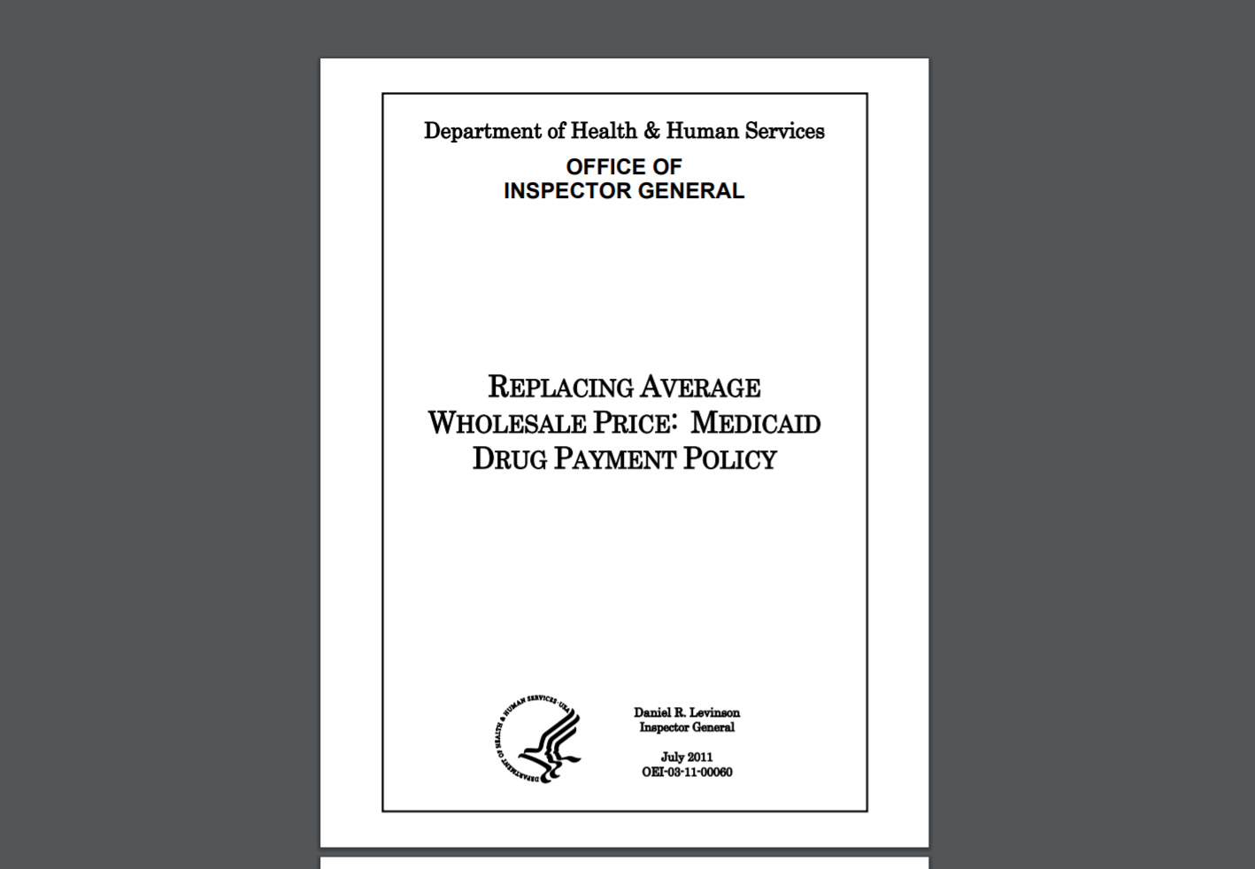
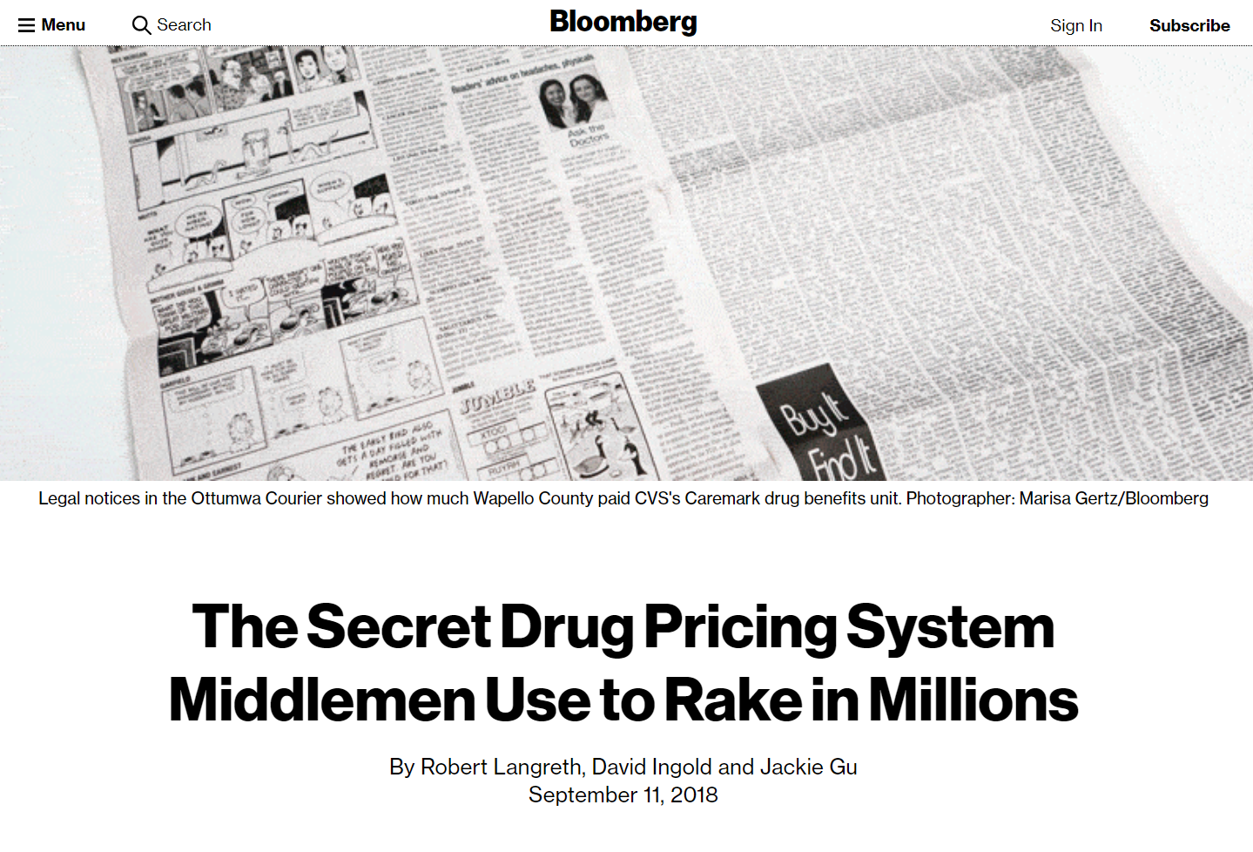
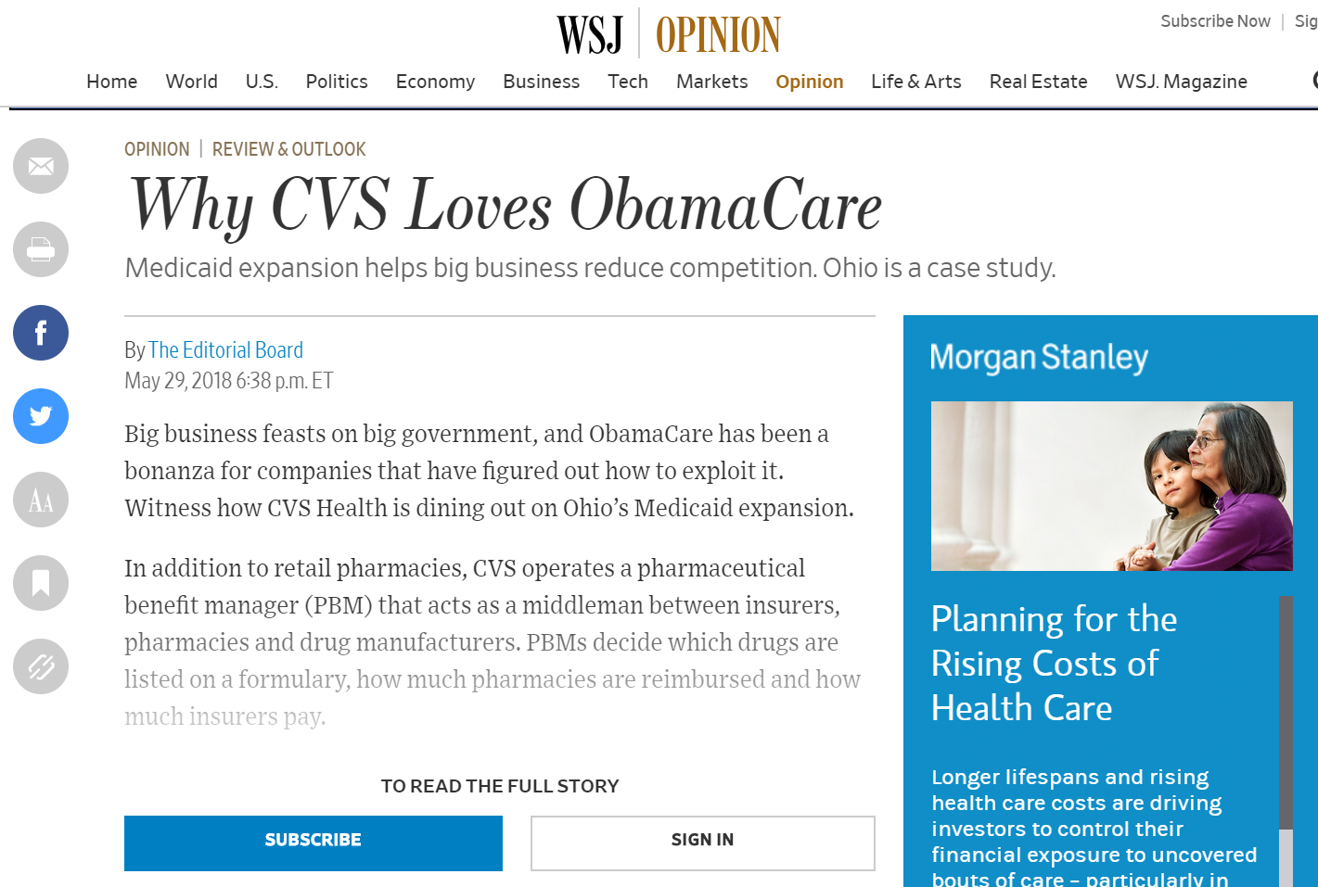
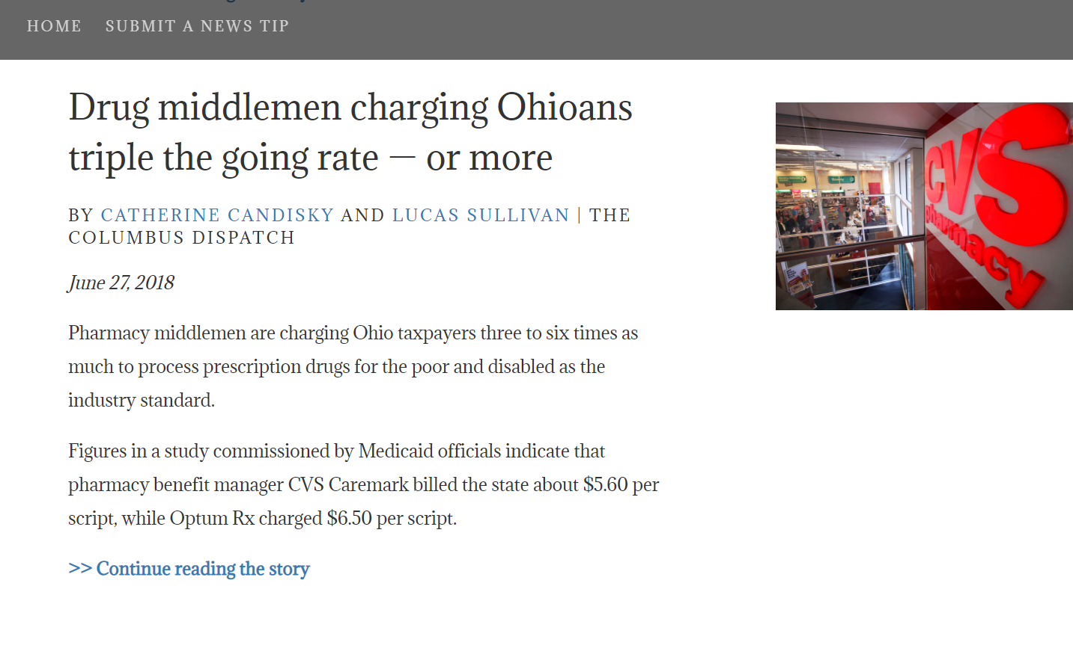
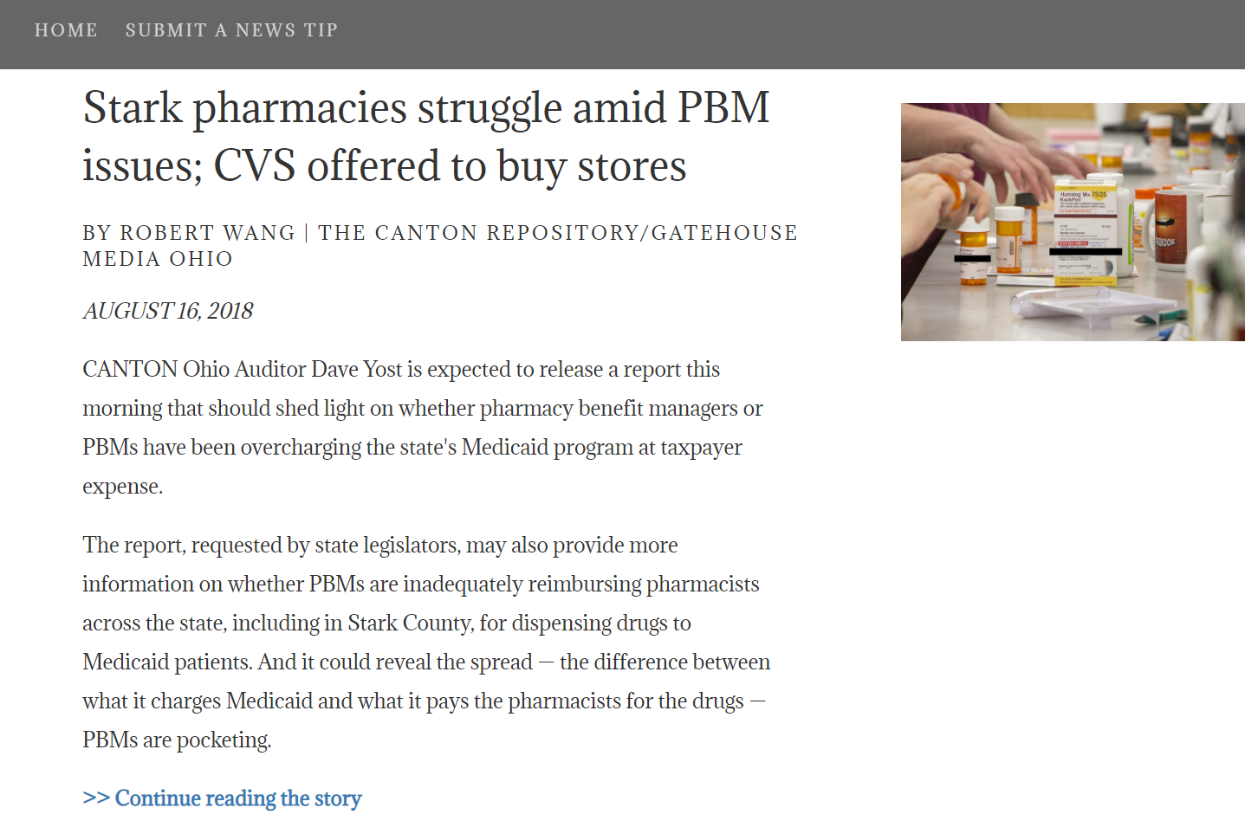
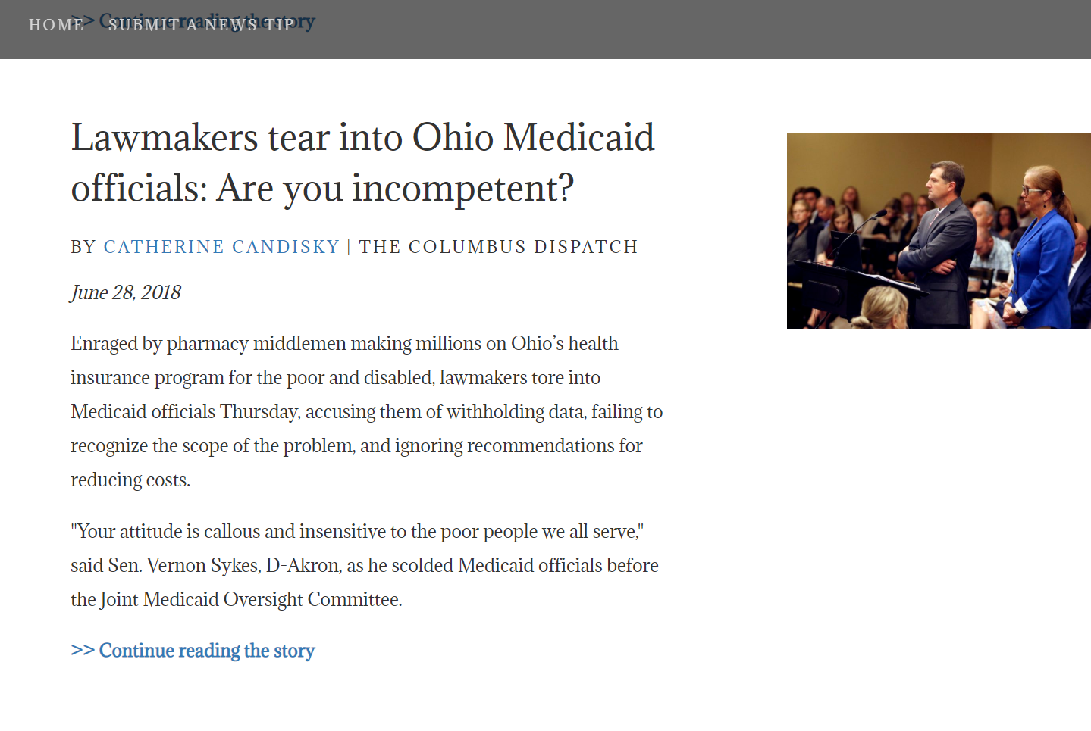
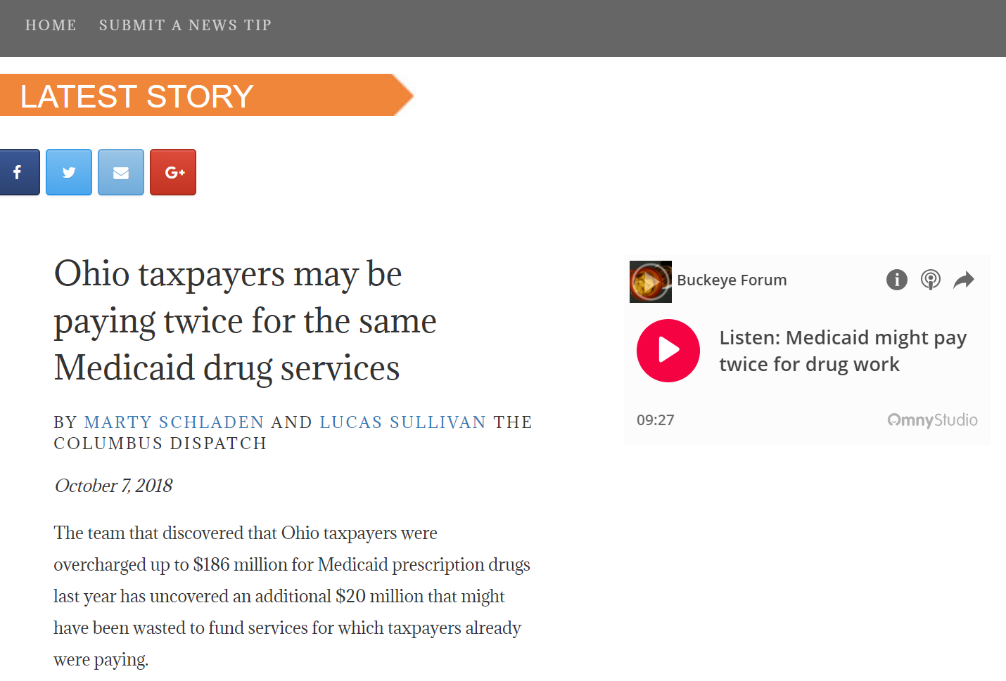
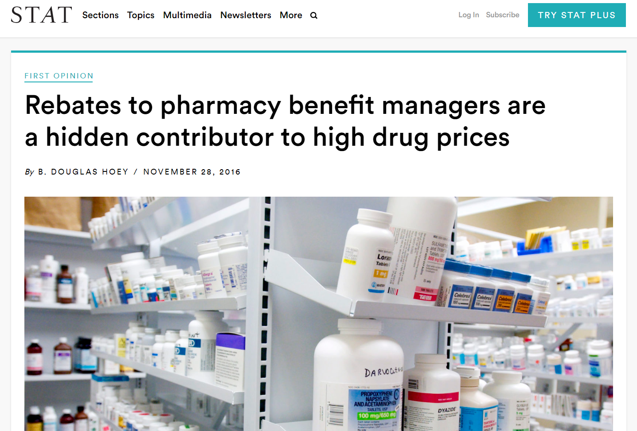
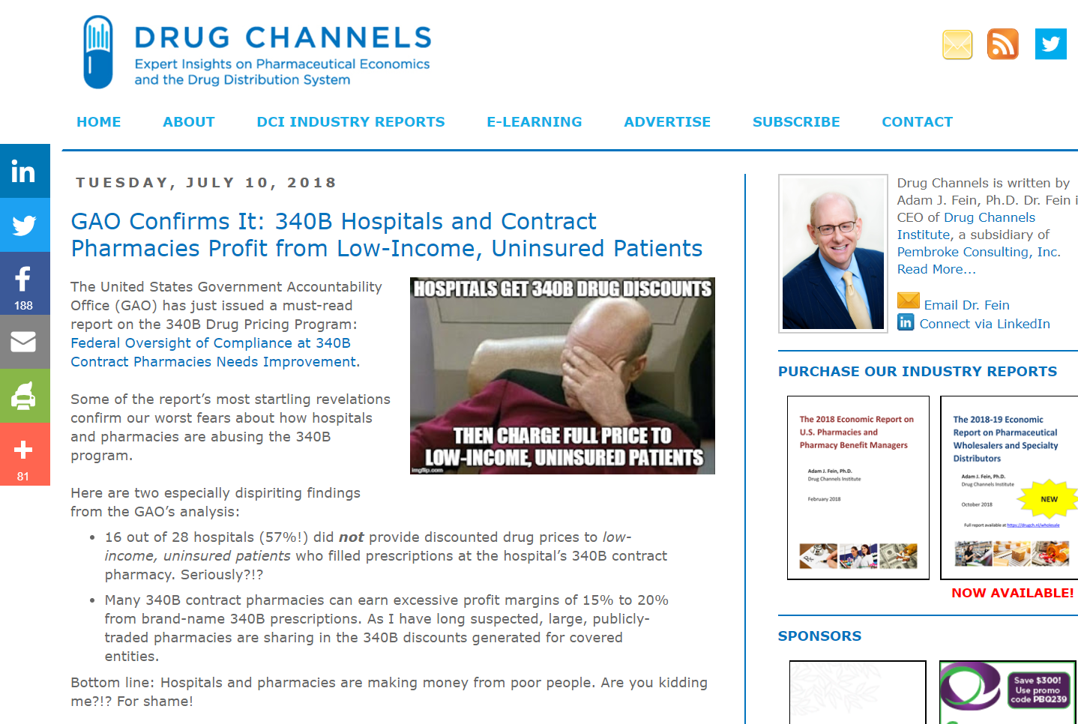
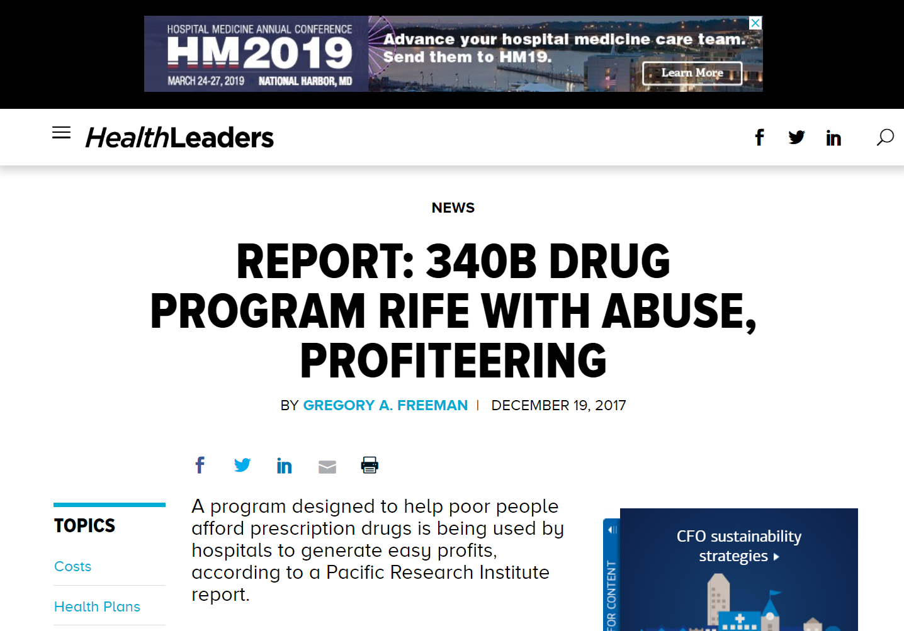
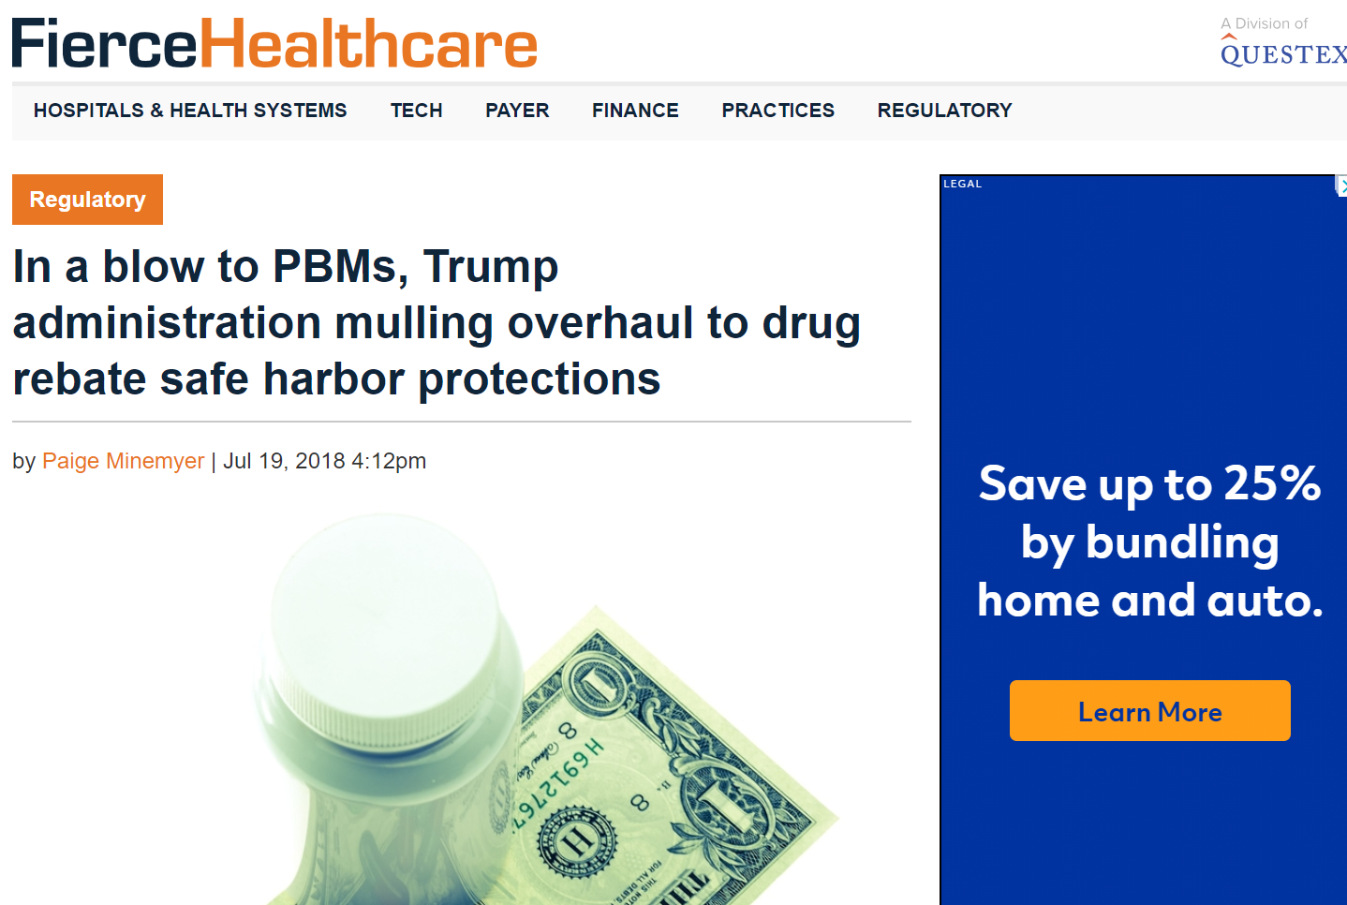
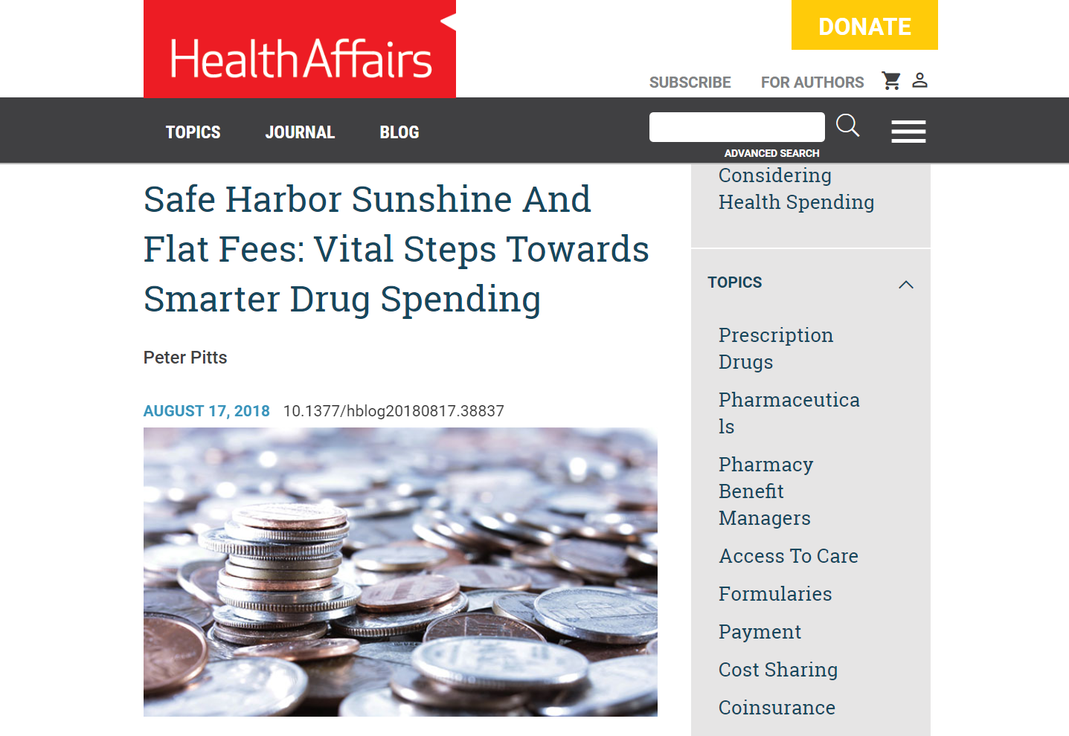
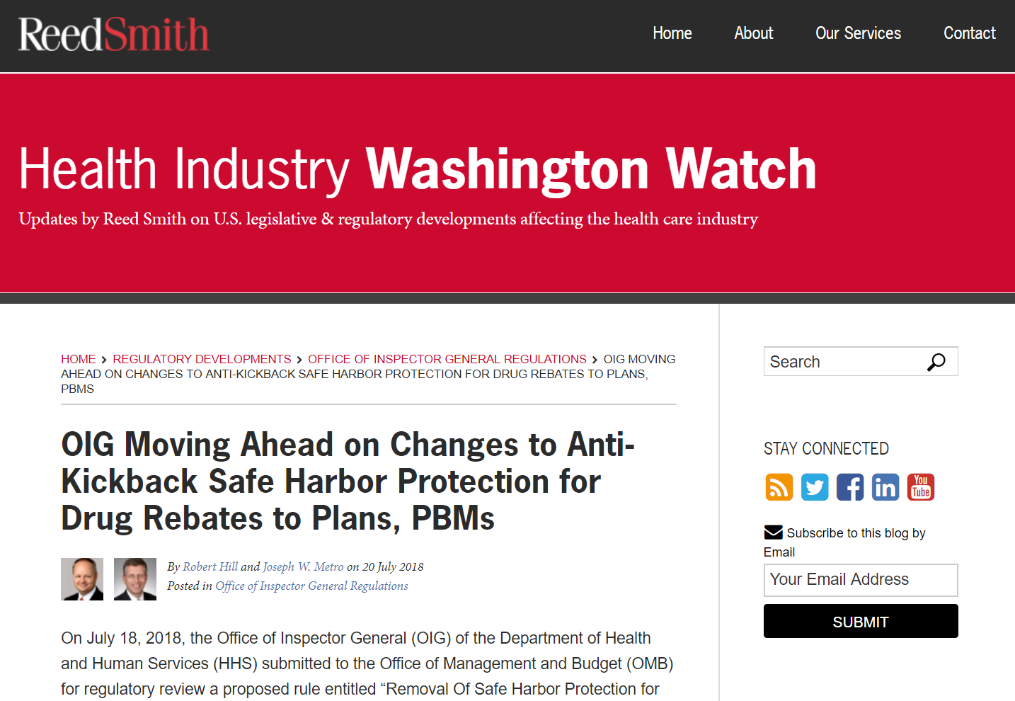
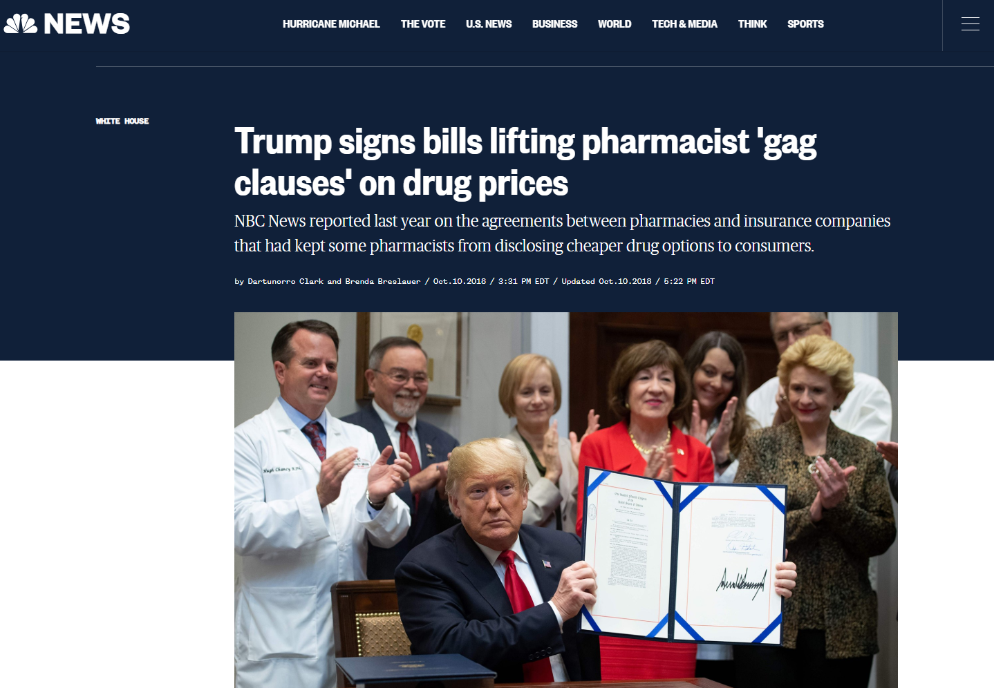
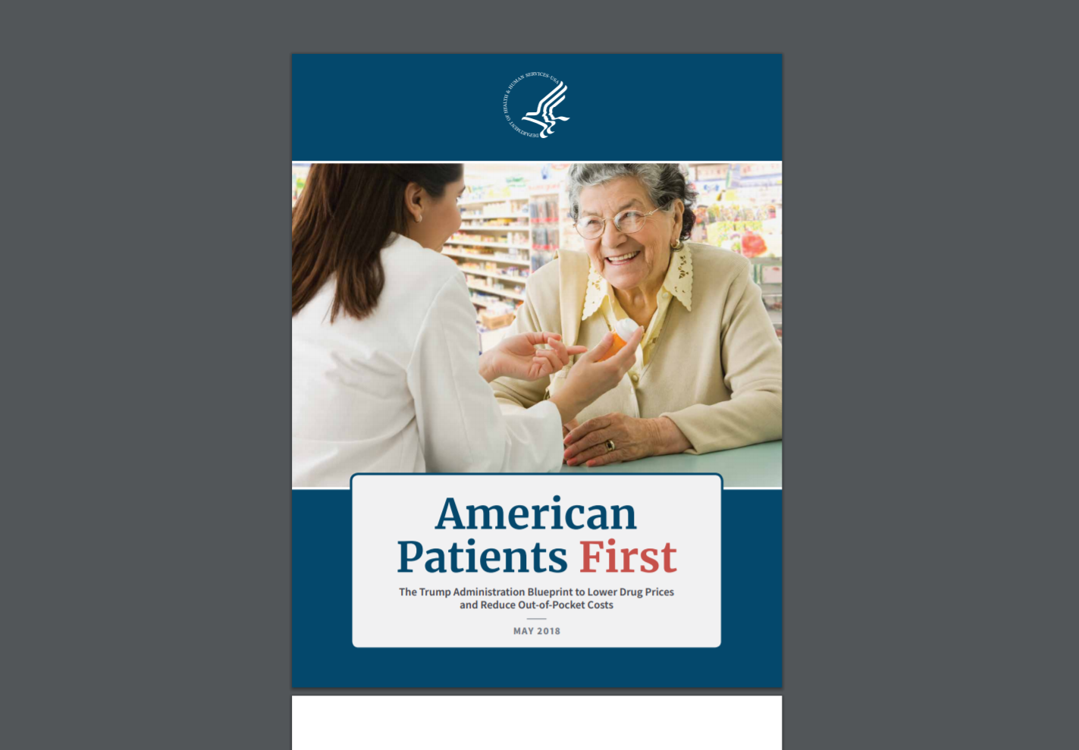
Lifting the PBM Curtain…
Notes:
Have articles coming in and fading out
Use the word document that Mike put together. Maybe make 5 second transitions. Use same slide during Q&A at the end.

Slide 2
Managed Care PBM Transparency: Lifting the Curtain
Michael Sharp, R.Ph.
President, SharpRx Pharmaceutical Consultation Services
Eric Pachman
Co-founder, 46brooklyn Research
President, ESP Consulting LLC
#CROSSROADS2018

Slide 3
Disclosures
Michael Sharp, R.Ph.
Served on an advisory board for Crossroads
Myers and Stauffer, LC (Consultant)
  Centers for Medicare and Medicaid Services
  Various State Medicaid programs
Eric Pachman
Performs data analytics consulting services for various independent pharmacies and pharmacy buying groups

Slide 4
Overview of Discussion Topics
State Medicaid Program Delivery Systems
Managed Care Pharmacy Framework/Services
Spotlight Issues in Medicaid Managed
Care Pharmacy
The Ohio Medicaid Managed Care
Pharmacy Experience
Perspectives Moving Forward
Q & A

Slide 5
State Medicaid Delivery Systems
Two general Medicaid delivery system approaches
  Fee-for-service (FFS)
  Risk based managed care (MCO)
States may utilize one, or a combination of the two
Approach typically depends on the population being served, access consideration and/or characteristics of the geographic regions in the state
  Rural, urban
*Source: CMS State Drug Utilization Data 2017, excludes 340B

Slide 6
State Medicaid Delivery Systems
Fee-For-Service
Managed Care
State enrolls and pays providers directly
State typically hires vendors to administer various functions or performs in-house
  Fiscal agent
  PBM
  Program integrity
  Enrollment brokers
  Medical policy
  Rate setting
  Other consulting services
Various approaches utilized across states
Any willing provider typically applies unless a state has a freedom of choice waiver approved by CMS
Requires waiver or State Plan Amendment (SPA) from CMS to implement
Health plans, coordinated care organizations (CCOs) or managed care organizations (MCOs) are paid a monthly, capitated rate to provide comprehensive care for members
Health plans pay providers directly, at risk for expenditures beyond capitation
Certain services or populations may remain in FFS (Carved Out)
  Pharmacy (all or specific drugs), dental, long term care, age, blind, disabled, certain disease states

Slide 7
Managed Care Pharmacy Framework/Services
Academic detailing
Ad-hoc reporting
Claims adjudication and pharmacy payment
Clinical edits (quantity limits, days supply, step therapy, dose optimization, prospective dug utilization review)
Commercial drug rebates
E-prescribing
Mail order including specialty management
Medication therapy
management (MTM)
Member, pharmacy and prescriber communication and web-site portal development
Network management
P&T committee
Pharmacy auditing
Preferred drug list management
Prior authorization
Procedure coded drugs
Retrospective DUR
Quarterly and annual reporting
State pharmacy policy support
Therapeutic interchange
Trend management

Slide 8
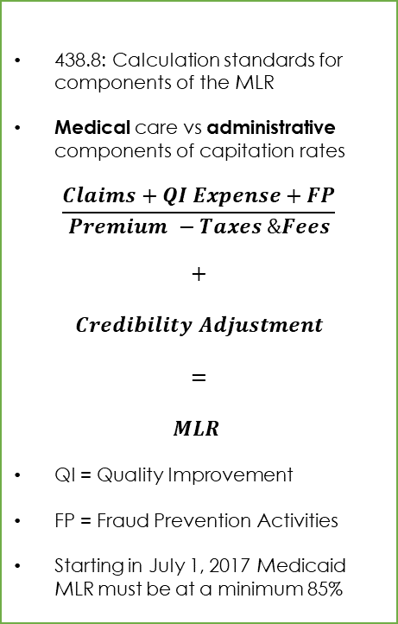
Highlights of Medicaid and CHIP
Managed Care Final Rule (CMS-2390-F)
Access/Quality
Reporting
Medical Loss Ratio (MLR)
Prescription drug coverage under Medicaid MCOs should demonstrate coverage consistent with the amount, duration, and scope as described by Medicaid FFS.
MCOs can not have medically necessary criteria for prescription drugs that are more stringent than FFS.
A managed care plan that agrees to provide coverage of a subset of covered outpatient drugs under the contract with the state needs to provide coverage of every covered outpatient drug included in the subset when the manufacturer of those drugs entered into a rebate agreement.
States are required to provide coverage of outpatient drugs that are not included in the managed care plan’s contract and the state may meet this obligation through FFS or another delivery system.
Managed care plans submit utilization data under section 1927(b)(2) of the Act within 45 calendar days after the end of each quarterly rebate period. 45 calendar days is the maximum limit. The 45 calendar day timeframe ensures managed care plan data is included in state utilization data submitted to manufacturers.
Utilization data must include, at a minimum, information on the total number of units of each dosage form, strength, and package size by National Drug Code of each covered outpatient drug dispensed or covered by the managed care plan.
States are required to submit utilization data to manufacturers for rebates no later than 60 days after the end of each rebate period (quarter).
438.8: calculation standards f
438.8: Calculation standards for components of the MLR
Medical care vs administrative components of capitation rates
$$\frac{Claims+QI Expense+FP}{Premium −Taxes \&Fees}$$
$$+$$
$$Credibility Adjustment$$
$$=$$
$$MLR$$
QI = Quality Improvement
FP = Fraud Prevention Activities
Starting in July 1, 2017 Medicaid MLR must be at a minimum 85%

Slide 9
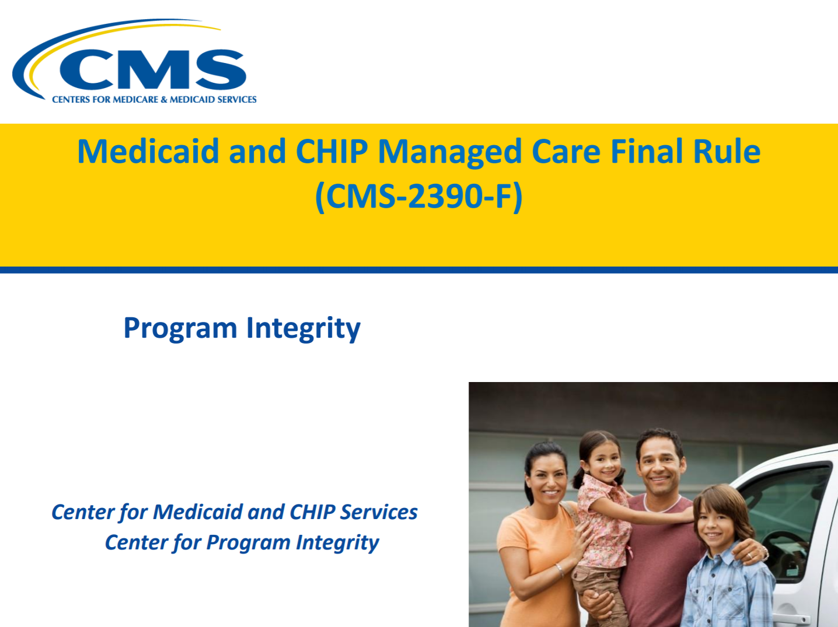
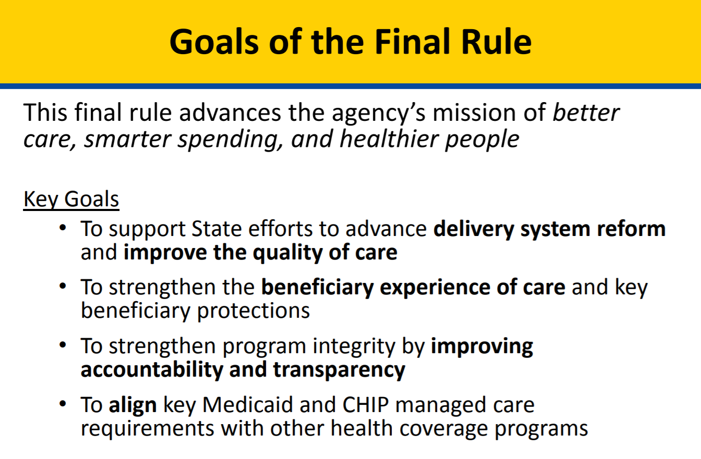

Goals of Medicaid and CHIP
Managed Care Final Rule (CMS-2390-F)
Source: https://www.medicaid.gov/medicaid/managed-care/downloads/program-integrity.pdf

Slide 10
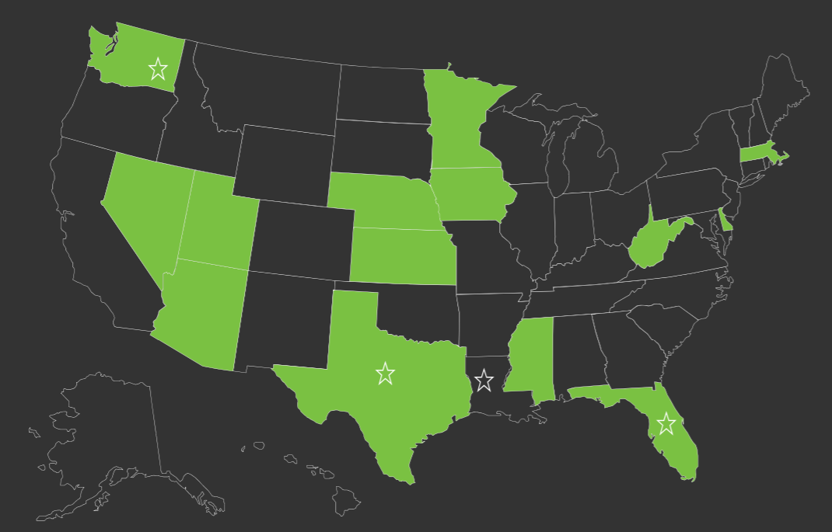
Spotlight Issues in Medicaid Managed Care Pharmacy
Managed Care States Utilizing a Single PDL
Preferred drug list administration
  MCO control vs. single/uniform PDL
  Rebate transparency
  Misaligned financial interests
  Provider administrative burden
340B pricing transparency
  FFS vs MCO requirements
  Program intent vs. profit
Spread pricing and payment transparency
  AAC vs. Traditional Commercial PBM Approach

Slide 11
Follow the Money - How are Benefit Managers and Pharmacies Paid?
Component | Fee-For-Service PBM | Managed Care PBM
Pharmacy Payment | Subject to CMS Rule 2345-FC: AAC requirement, SPA approval by CMS | Commercial approach, unless state chooses to dictate (Mississippi)
Brand Drugs | NADAC*, AAC, WAC, MAC | AWP minus, variable discount for specialty drugs
Generic Drugs | NADAC*, AAC, WAC, MAC, FUL | Generic Effective Rate (GER) guarantee based on AWP via MAC
340B | 340B ceiling price, 340B AAC, MAC | Normal rates unless state chooses to dictate (Iowa)
Pharmacy Dispensing Fee | Professional dispensing fee as determined by survey ($10-12) | Nominal ($.50-1.50)
Rebates | Federal and supplemental 100% pass through | Commercial: Percentage shared with MCO based upon contract
PBM Services Payment | Flat fee, PA volume tiers, ad-hoc reporting-variable. Revenue based on services. | Revenue provided by GER “spread” and commercial rebate sharing
Transparent | Yes | No - generally
* “NADAC” stands for National Average Drug Acquisition Cost. It is calculated via a monthly survey of nationwide retail community pharmacies, in which the pharmacies voluntarily supply their current invoice costs for all purchased drugs. The full methodology can be accessed here: https://www.medicaid.gov/medicaid-chip-program-information/by-topics/prescription-drugs/ful-nadac-downloads/nadacmethodology.pdf

Slide 12
The Mechanics of PBM “Spread”
PBM signs a “traditional” contract with MCO that typically includes a Generic Effective Rate (GER) guarantee
  MCO pays a discount to Average Wholesale Price (AWP) for aggregate generic spend
  Usually has no linkage to actual drug acquisition cost
PBM signs separate contracts with the pharmacy to pay out claims based on Maximum Allowable Cost (MAC)
  Proprietary benchmark pricing that pharmacy has limited ability to challenge
  Usually closer to, or potentially below, acquisition cost
PBM keeps difference between charge billed to MCO and ingredient reimbursement to pharmacy

Slide 13
How are WAC/AWP/SWP set?
Drug Type | WAC | AWP-Calculated | AWP-Suggested (SWP)
Brand | Supplied by manufacturer | WAC x 1.2 markup for most brands, when no suggested AWP supplied. | Occasionally supplied by manufacturer
Generic | Supplied by manufacturer. No correlation to AAC. | Typically not calculated via markup. No correlation to AAC. | Supplied by manufacturer. No correlation to AAC
WAC and AWP for clotting factor and immune globulin typically do not have any correlation to AAC.
By entering into an AWP-based GER contract on generic drugs, a payer is signing up for a fixed percentage discount off an unknown combination of meaningless numbers

Slide 14
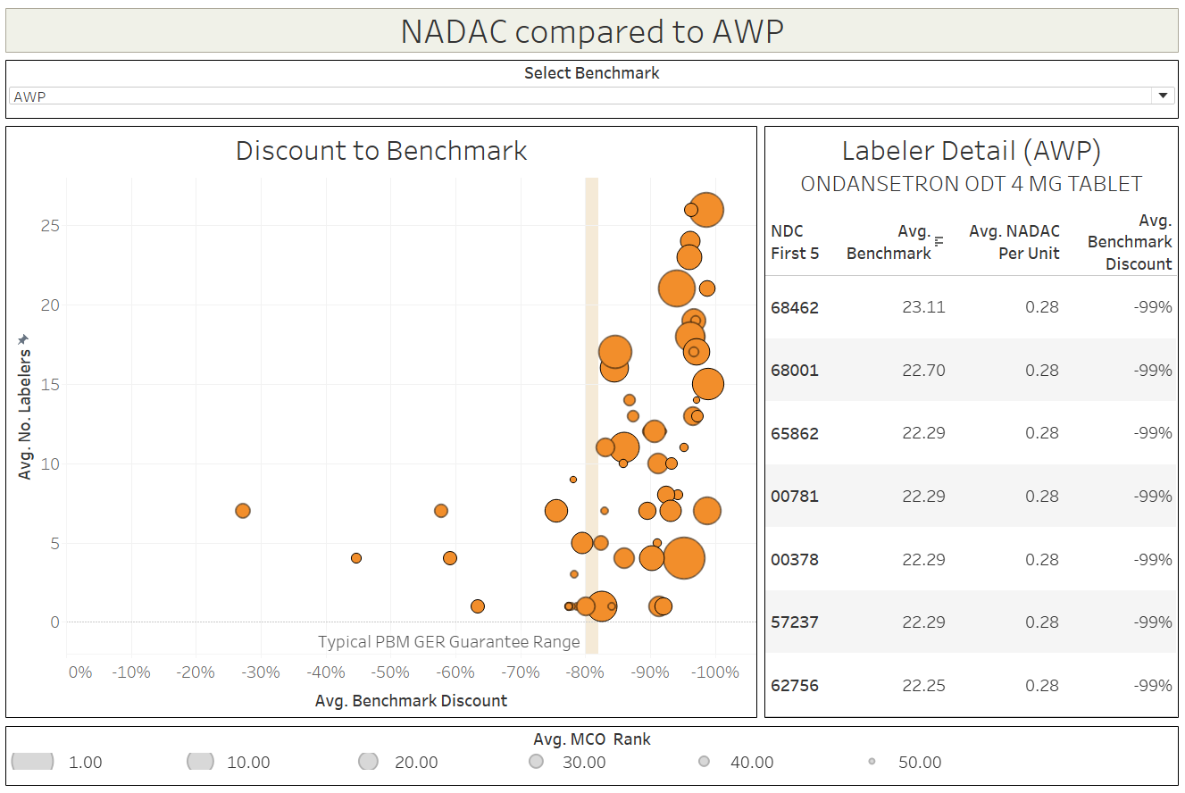
Visualizing the AWP disconnect on the top 50 Managed Care Medicaid generic drugs

Slide 15
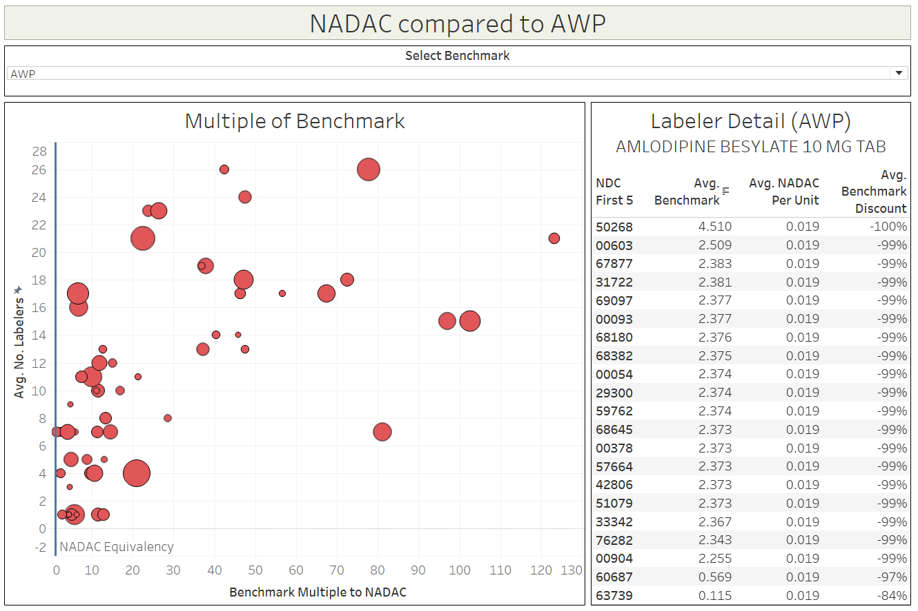
Visualizing the AWP disconnect on the top 50 Managed Care Medicaid generic drugs

Slide 16
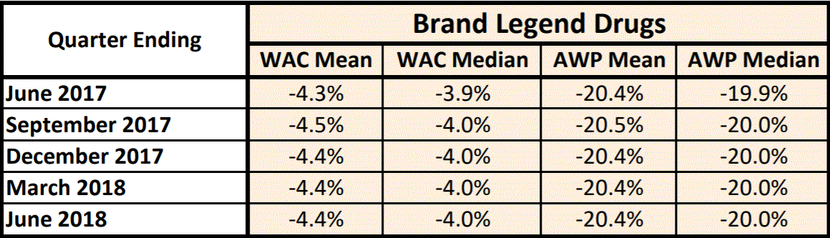
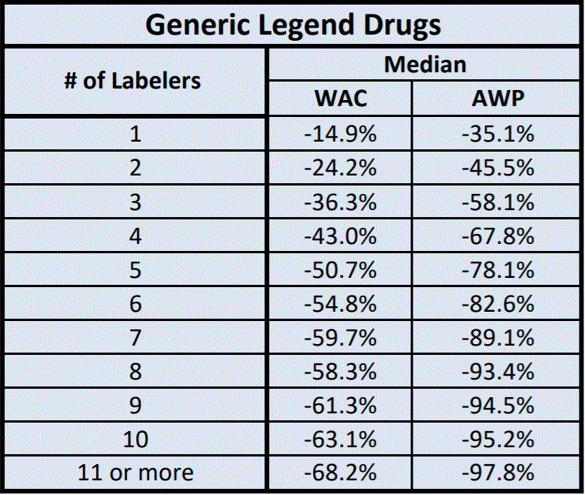
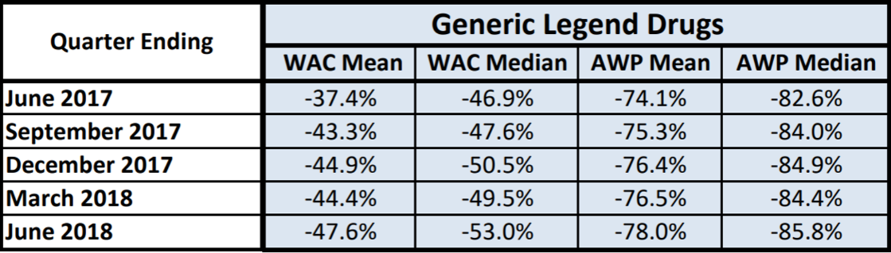
Another way of looking at it – NADAC equivalency
WAC and AWP for clotting factor and immune globulin typically do not have any correlation to AAC.
AWP and WAC are very poor representations of actual generic cost
GER contracts based on AWP have virtually no pricing transparency
Source: https://www.medicaid.gov/medicaid/prescription-drugs/downloads/retail-price-survey/nadac-equiv-metrics.pdf

Slide 17
ROAD TO OHIO MEDICAID MANAGED CARE (MCO) TRANSPARENCY
Major Caresource MAC Update in April ‘16
Pharmacy identifies MCO generic payment issue
2016
Q1
Q2
Q3
Q4
The start of downward pressure on MCO Reimbursements
MCO Generic Gross Margins sink to $1 per prescription
2017
Major MAC cut on 10/26 brings attention back to PBMs
Transparency regulation fails
Q4
Q3
Q2
Q1
2016-2018
2018
MCO Generic Gross Margins turn negative
Amendment to regulate PBM spread / fix dispensing fees is removed from budget at last minute
46Brooklyn Research formed
Columbus Dispatch commences coverage of Medicaid drug pricing
Medicaid hires HDS to audit Rx program
Auditor Yost releases results of PBM study
Goal = use public data to investigate, expose, and explain Rx supply chain distortions
Q1
Q2
Q3
Q4
2019
Dispatch’s “Side Effects” series includes 30+ articles investigating Ohio’s drug pricing crisis
Finds $224 million in annual spread
Medicaid announces ban on spread pricing starting Jan 1, 2019

Slide 18
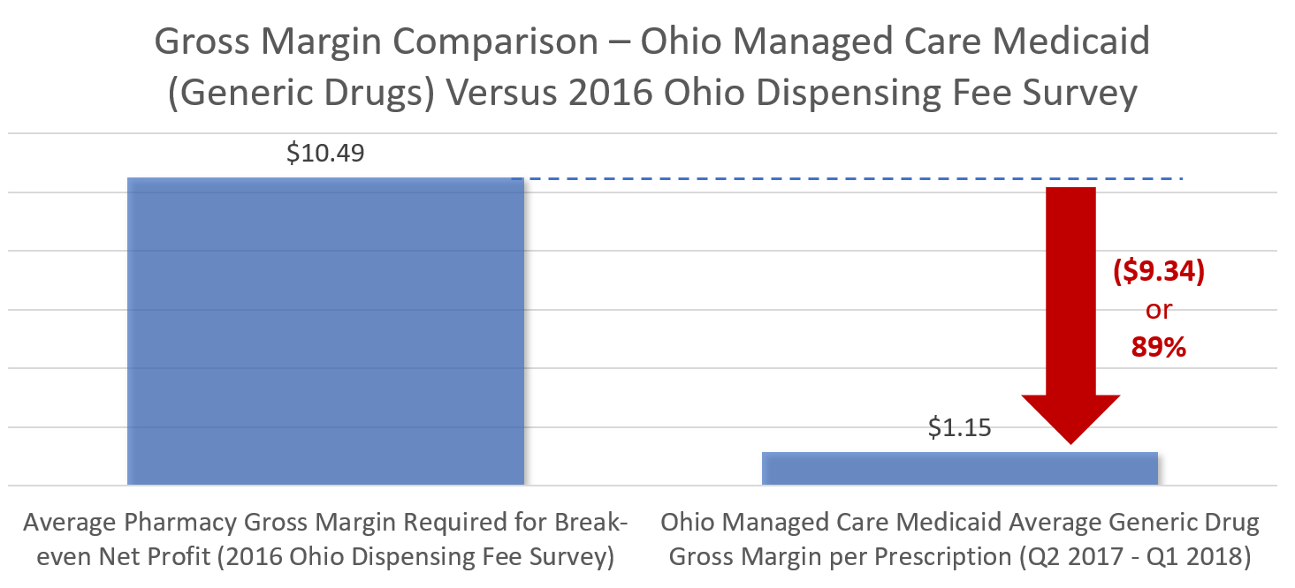
Welcome to Retail Pharmacy! Something is very wrong here…
Source: 46brooklyn Research – derived from combining data from Auditor Yost’s report on PBM, CMS’ State Utilization Database, and CMS NADAC Database

Slide 19
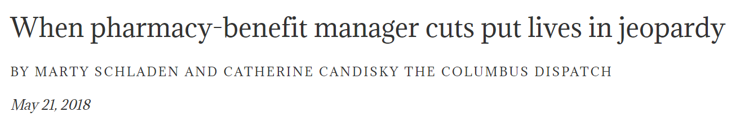
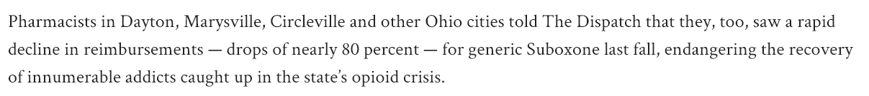
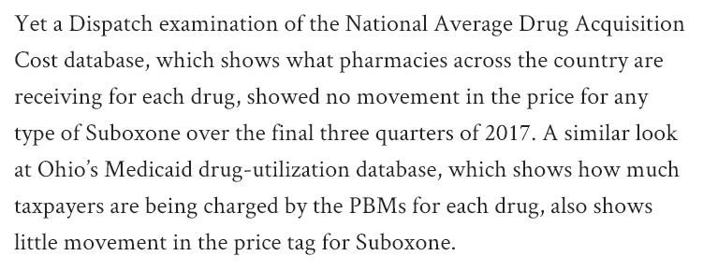
Q4 2017: Ohio Managed Care Pricing Cuts Hit Generic Suboxone

Slide 20
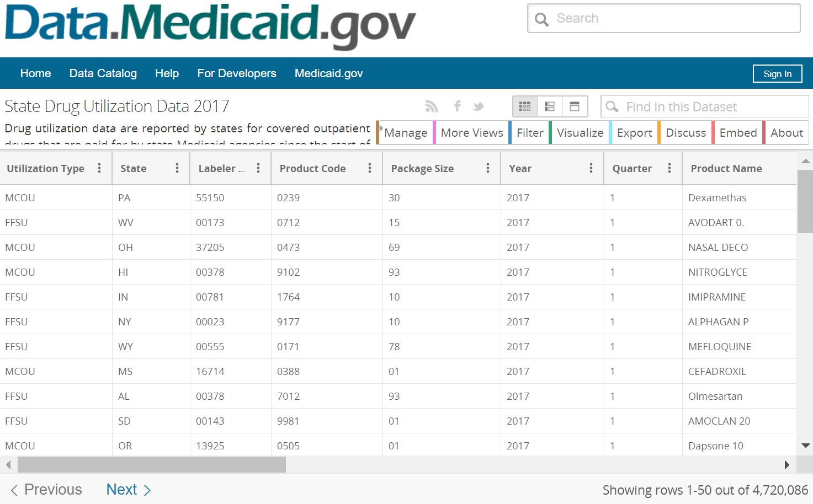
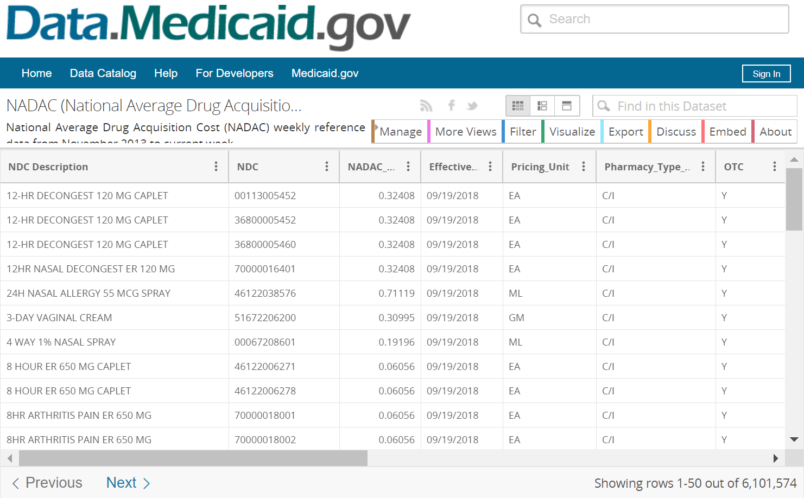
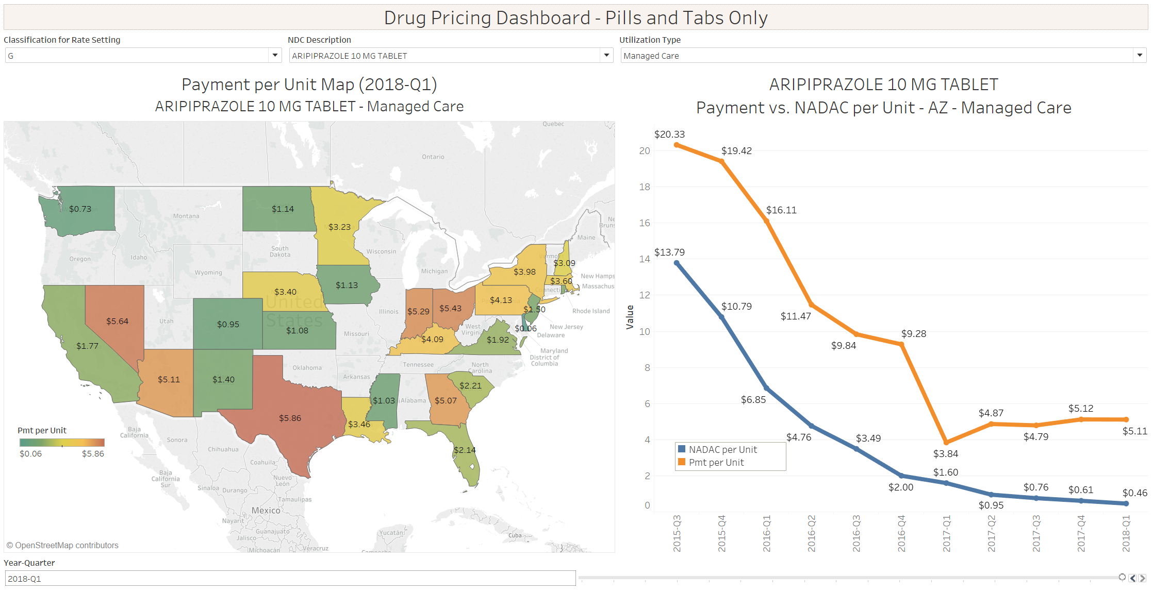

Challenge: How do we illustrate poor MCO pricing transparency using only public data?
State Utilization (2014-2018)
Join on:
NDC
Year-Quarter
NADAC (2014-2018)
Arizona MCOs reported paying 11.1x the NADAC for Aripiprazole 10 MG in Q1 2018

Slide 21
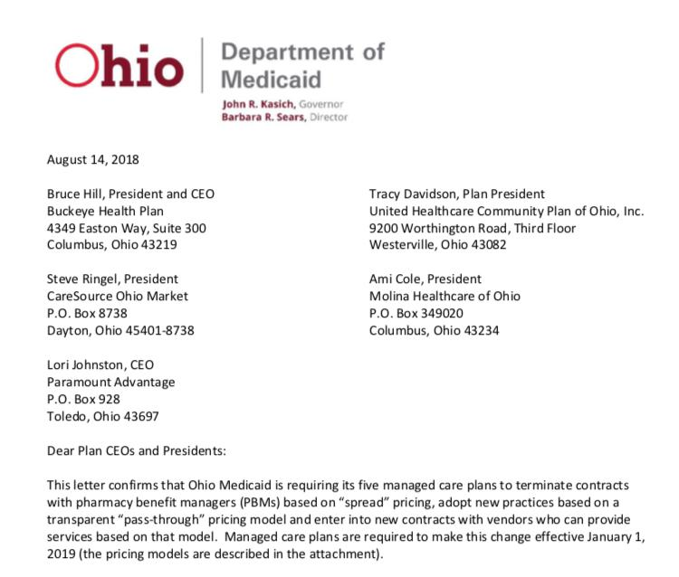
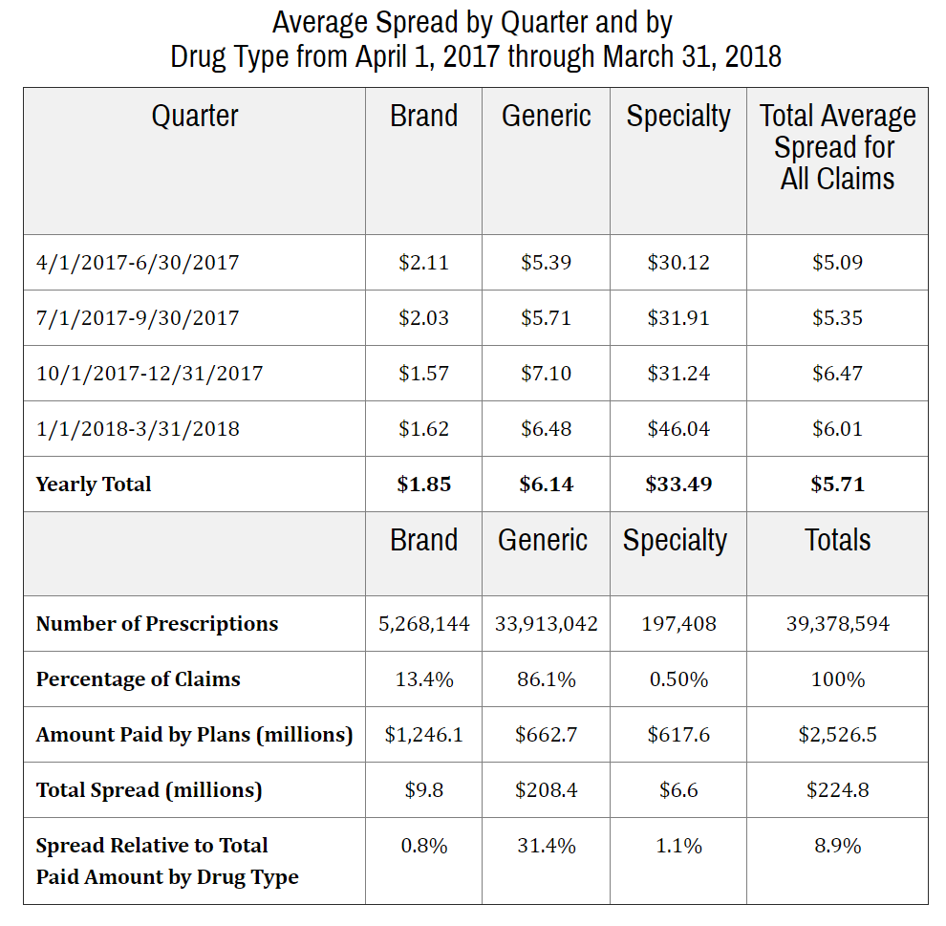
Q2/Q3 2018: The Dam Breaks
Ohio finds $225 million in PBM Spread
Ohio to eliminate spread pricing starting Q1 2019
Source: https://ohioauditor.gov/auditsearch/Reports/2018/Medicaid_Pharmacy_Services_2018_Franklin.pdf

Slide 22
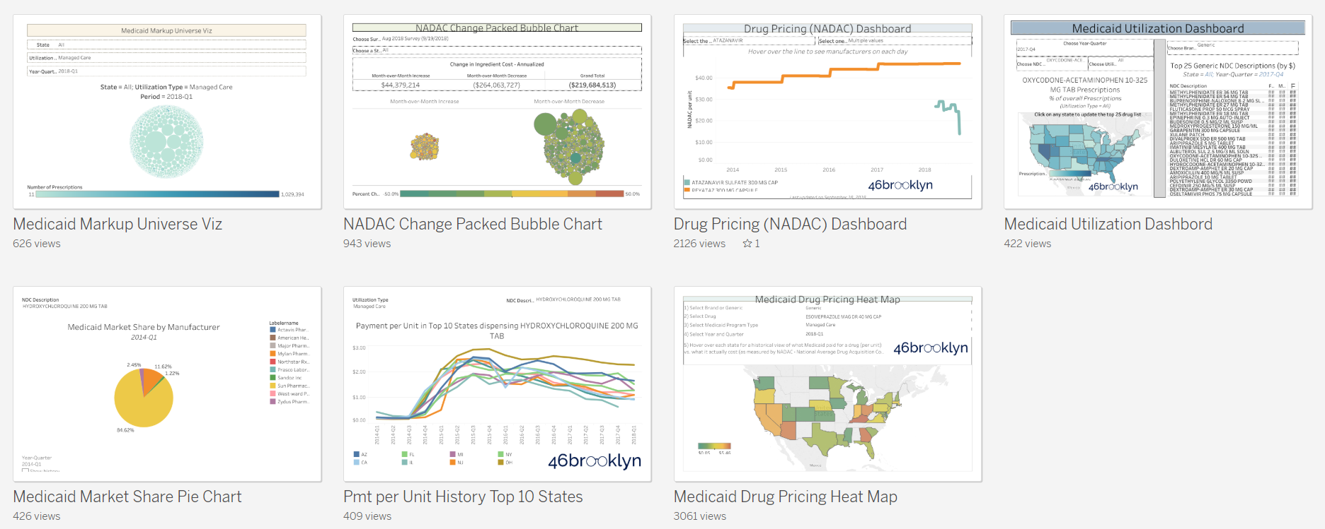

We can do a lot with public data – and we are just scratching the surface!
https://www.46brooklyn.com/visualizations/

Slide 23
Perspectives Moving Forward
Transparency based PBM contracts will become the new standard
  Pharmacy reimbursement - Alignment with FFS methodologies
  Ingredient cost guarantees - New meaningful benchmarks for aggregate Generic Effective Rate calculations-NADAC, State AAC, other
  Dispensing fee requirements
  Transparent payment based upon actual PBM services provided
  Performance bonuses based upon trend management, innovation and clinical intervention success
Managed Care Pharmacy Encounter Claims
  Claims will be thoroughly audited on a routine basis
  Actual reimbursement amounts paid to pharmacies will be compared and validated to encounter claims provided to state
Medical Loss Ratios (MLR) Requirements
  Audited and heavily scrutinized to ensure that “Spread” is not included in the medical spend numerator of the MLR.
  Reporting for FY17 Medicaid MLRs expected in July 2019
  Potential recoupment and litigation

Slide 24
Perspectives Moving Forward
Single Preferred Drug Lists (PDLs) and Aligned PDL Expansion
  State specific prohibition of managed care rebate collection
  Potential OIG changes to Safe Harbor allowances for drug rebates and consideration as kickbacks
  Alignment of net financial interest to the taxpayer/state/feds
    Insulins/follow on brands-505(b)(2), innovator biologics/biosimilars, multiple source brands with net pricing wins
Pharmacy Carve Out Consideration
  Administrative simplification
  Transparency in benefit design and prior authorization protocols
  Alignment with CMS Managed Care Rule pharmacy principles
340B Transparency and Payment Reform
  State Medicaid programs will establish uniform policies across FFS and MCO

Slide 25

Q&A

Slide 26
Lifting the PBM Curtain…
Notes:
Have articles coming in and fading out
Use the word document that Mike put together. Maybe make 5 second transitions. Use same slide during Q&A at the end.

Slide 27
Speaker Contact Information
Michael Sharp, R.Ph.
SharpRx Pharmaceutical Consultation Services, INC. www.sharprx.net
Mike@sharprx.net
Eric Pachman
46Brooklyn Research
www.46brooklyn.com
Eric@46brooklyn.com

Slide 28
Appendix

Slide 29
Speaker Bio: Michael Sharp, R.Ph.
Michael Sharp, R.Ph. is currently President of SharpRx Pharmaceutical Consultation Services (www.sharprx.net). In this capacity he has worked with several clients, including Myers and Stauffer, LC, the Centers for Medicare and Medicaid Services (CMS), multiple state Medicaid programs, several research and consulting bureaus, pharmaceutical manufacturers and the Indiana Attorney General’s Offices’ Medicaid Fraud Control Unit. Mike has played a significant and ongoing role in the CMS National Average Drug Acquisition Cost (NADAC) project. He has been heavily involved in the design, development, implementation, maintenance, management and stakeholder communications since the inception of the NADAC initiative in 2011.
Prior to his current position, Mike was the Director of Pharmacy for the State of Indiana Medicaid pharmacy program. In this capacity, he was responsible for all aspects of pharmacy benefit administration, including budgeting, staff supervision, legislative affairs, compliance with all state and federal laws and contractor performance related to drug rebates, clinical services, prior authorization, claims processing, reimbursement and implementation of new program initiatives. Mike represented Region V states on the CMS Pharmacy Technical Advisory Group.
Mike has significant experience in Medicaid pharmacy benefit management and has developed multiple innovative solutions for addressing program needs within the Medicaid pharmacy space. Areas of expertise include drug pricing, regulatory affairs, claims processing, pharmacy informatics, procedure coded drugs, drug rebates, expert testimony and both Medicaid and commercial pharmacy benefit management. Mike has pharmacy practice experience in the pharmaceutical industry (Eli Lilly and Company), drug file compendia (Medi-Span), long term care and retail pharmacy areas. He has been a guest lecturer for pharmacy classes at both Butler and Purdue University. Mike holds a B.S. in Pharmacy Practice from Butler University College of Pharmacy and Health Sciences. He has been licensed as a pharmacist in the State of Indiana since 1993.

Slide 30
Speaker Bio: Eric Pachman
Two years working as President of a chain of community pharmacies was all the exposure Eric needed to know something was very wrong with our prescription drug supply chain. Eric left in July 2018 and formed 46brooklyn Research (www.46brooklyn.com) to explore the disturbing complexity of our country’s prescription supply chain. 46brooklyn Research freely shares its work with the public through interactive data visualizations designed to make it easier for users to learn from public drug pricing and utilization databases, and original research that dives deep into the inner workings of the supply chain.
Eric has 17 years of experience across a wide variety of technical and management roles on both “Wall Street” and “Main Street.” He has worked within, invested in, and studied dozens of industries over his professional career – and in Eric’s opinion, this one is by far the most complicated.
Eric graduated from University of Florida in 2001 with a BS in Chemical Engineering, and obtained an MBA from Harvard Business School in 2008.

Slide 31
Additional Detail on SWP/AWP
Medi-Span
Suggested Wholesale Price (SWP) is the price that a manufacturer reports to Medi-Span as the price that the manufacturer suggests that wholesalers charge when selling the manufacturer’s drug to the wholesaler’s customers. The SWP does not necessarily represent the actual sales price used by a wholesaler in any specific transaction or group of transactions with its own customers. Wholesalers determine the actual prices at which they sell drug products to their respective customers, based on a variety of competitive, customer and market factors.
First DataBank
Suggested Wholesale Price (SWP) as published by FDB represents the manufacturer's suggested price for a drug product from wholesalers to their customers (i.e., retailers, hospitals, physicians and other buying entities) as reported to First Databank by the manufacturer. SWP is a suggested price and does not represent actual transaction prices. First Databank relies on manufacturers to report or otherwise make available the values for the SWP data field.
http://www.wolterskluwercdi.com/sites/default/files/documents/WKH_AWP_Policy.pdf
https://www.fdbhealth.com/policies/drug-pricing-policy/

